Slide 1
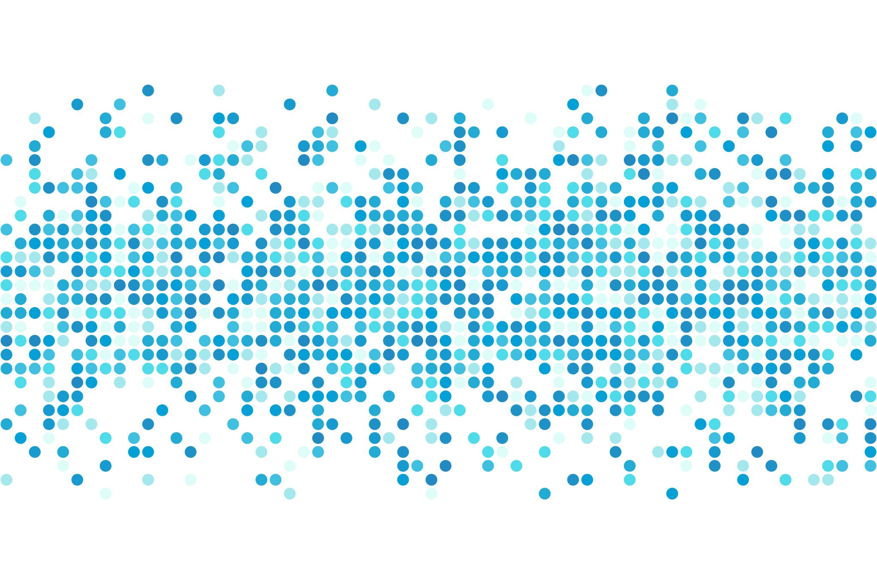

Alcohol Consumption Effects on High school performance
Kiana Gonzalez-Rodholm

Slide 2
Business problem
How does alcohol consumption affect high school performance?
Are there other factors that contribute to students’ grades other than alcohol?
Can we predict how a student is going to perform in school using alcohol consumption and other social/economic factors?

Slide 3
A look at the Data
Two classes (Math and Portuguese) with three periods worth of final grades.
Personal data on each student:
School, sex, age, family size, parental status (together or divorced), mother/father’s education, mother/father’s job, guardianship, current health.
Educational data on each student:
Study time, home to school travel time, if they are getting educational support, want to pursue higher education after high school, number of absences.
Social data on each student:
Weekday and weekend alcohol consumption, free time after school, whether they go out with friends, romantic relationship status, extracurricular activities.

Slide 4
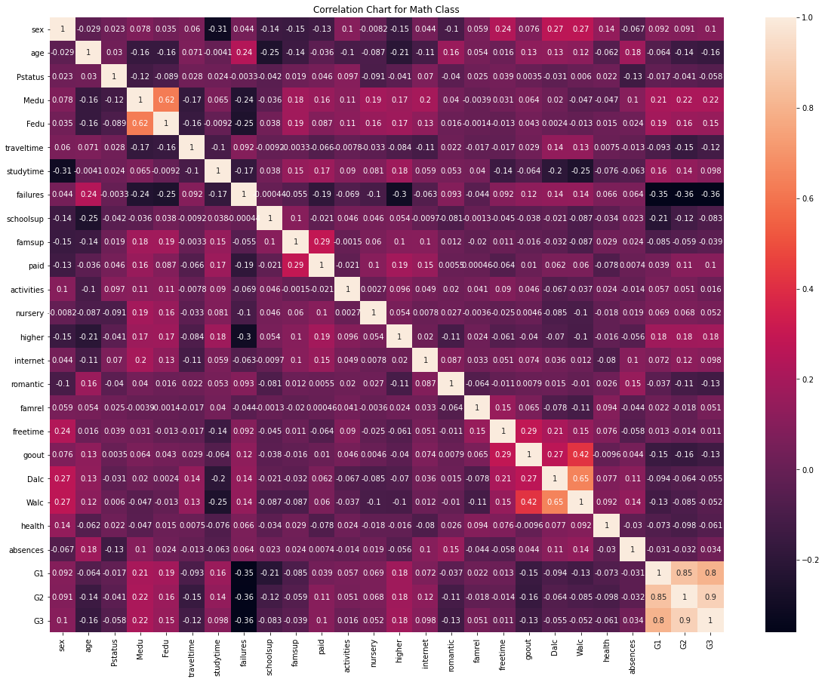
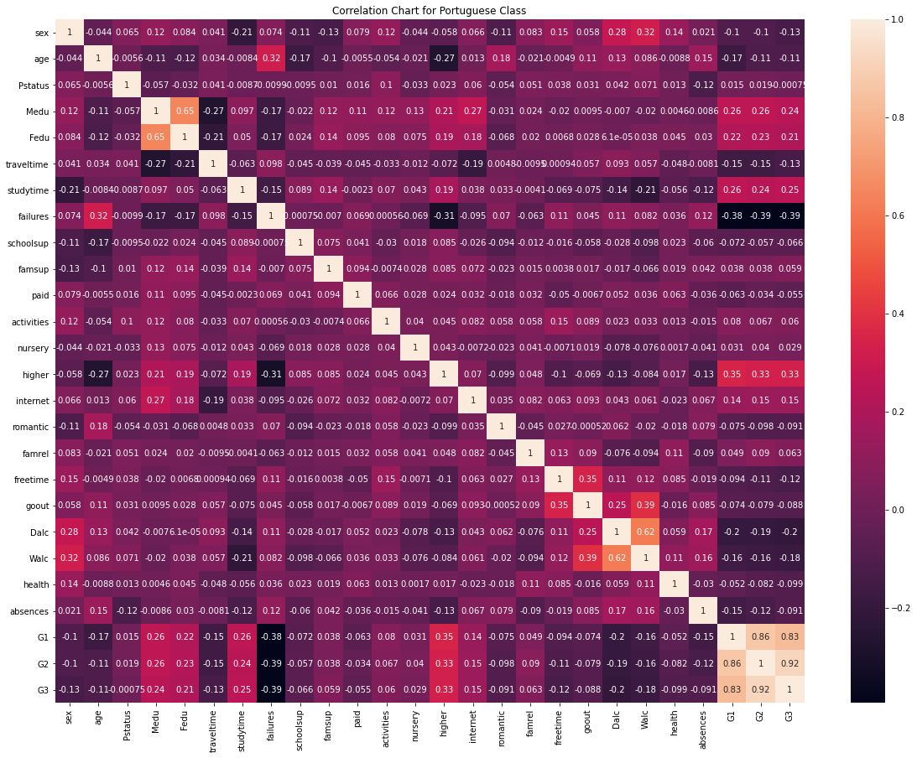
Preliminary Analysis Correlation Charts for Each Class

Slide 5
What does this mean?
Positive correlations with grades:
Mother and father’s level of education, amount of time the student spent studying, and those students that indicated they wanted to pursue higher education showed a positive correlation in grade performance.
Negative correlations with grades:
The math class showed that going out with friends and having failed previous classes showed a decrease in students’ grades.
The Portuguese class also showed failing classes in the past negatively correlated to grades, but also the weekday and weekend alcohol consumption was some of the more highly negative correlations.

Slide 6
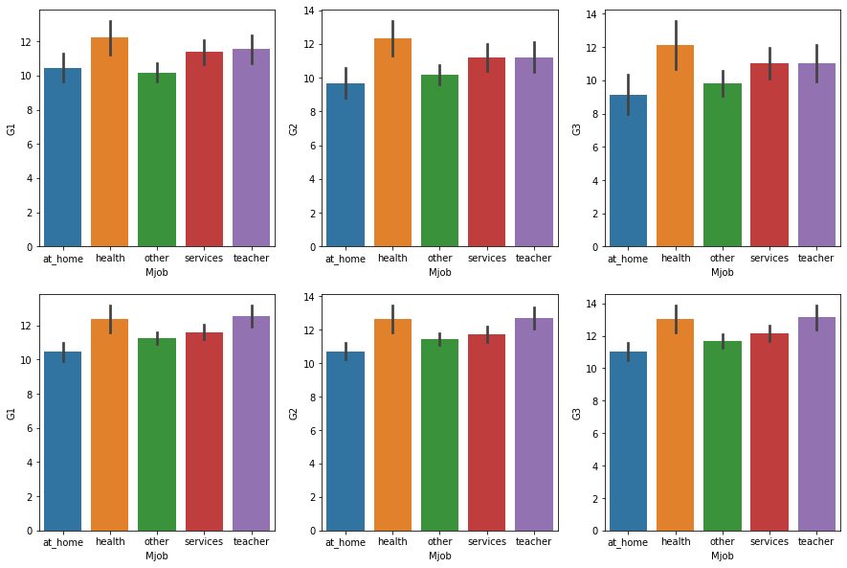
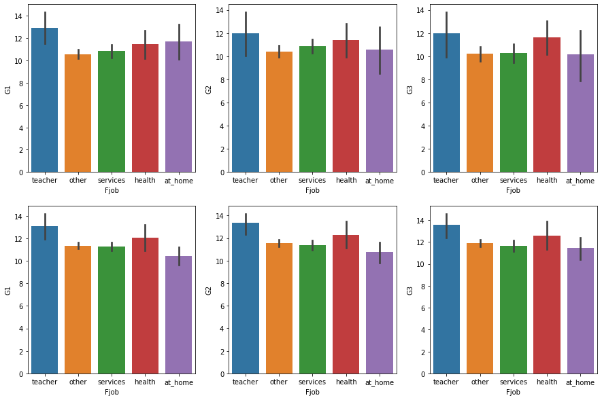
Preliminary Analysis Bar Charts of Mother and Father’s job

Slide 7
What does this mean?
Students whose mothers were in the health field and fathers who were teachers tended to do better in school than those with parents in other careers.
In both mothers and fathers, the second highest performing career was the opposite for each: mothers who were teachers and fathers in the health field also did well in school.

Slide 8
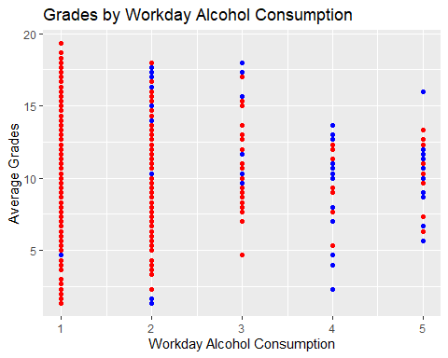
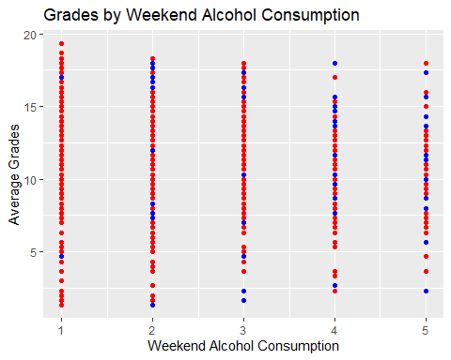
Preliminary Analysis Alcohol Consumption and Grades
Portuguese = red dots
Math = blue dots

Slide 9
What does this mean?
Students in the math class tend to drink more alcohol on weekdays. Students who consume large amounts (4-5 rating) of alcohol during weekdays do slightly worse in school performance.
The weekend alcohol consumption of students seems evenly spread overall and across the two classes and doesn’t seem to influence grades.

Slide 10
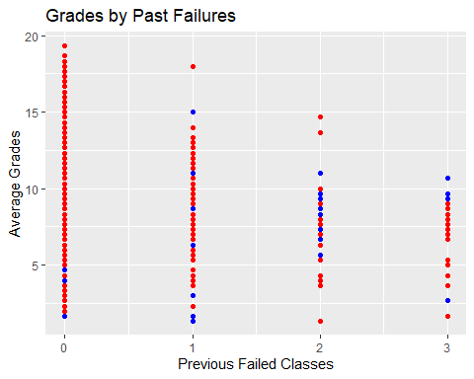
Preliminary Analysis Grades with Past Failures
What does this mean?
The students who had more failed classes tended to have lower grades.
There is a general downhill slope in grade performance the higher the number of failed classes there were.
Portuguese = red dots
Math = blue dots

Slide 11
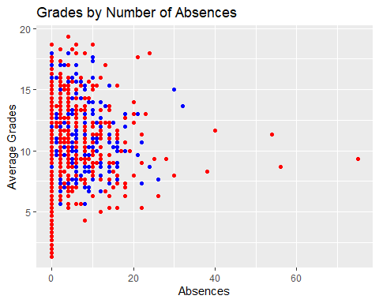
Preliminary Analysis Grades by Number of Absences
What does this mean?
Most students did not have more than 20 absences for the duration of the study (one school year).
Those students with zero absences tend to have a wide spread of grades.
There doesn’t appear to be a negative correlation between absences and grades.
Portuguese = red dots
Math = blue dots

Slide 12

Predictive Analysis: Random Forest Regression Model
This model operates by constructing several decision trees during training time and outputting the mean of the classes as the prediction of all the trees. This method tends to do better than a regular decision tree model since it uses the means as well.
Source: https://en.wikipedia.org/wiki/Random_forest

Slide 13
Intermediate results
By running each class individually, I was able to achieve a prediction model with about a 40% training accuracy and a 30% testing accuracy.
I then averaged the grades for each period and ran the model again, and got similar results, ranging from around 25%-45% accuracy.

Slide 14
Predictive Analysis: Random Forest Classifier Model
What was done differently?
I created new variables which classified the final grade as pass or fail.
A pass grade was anything in the 50th percentile or higher was given a value of 1, anything else was a 0 (fail).
I then combined the three periods of grades into one final pass or fail grade by using a best 2 out of 3 score.
This model is built the same way as the Random Forest Regression model but rather than using the actual values, it uses set values like 1 and 0 which most of our data was transformed into (dummy variables). Just like the name suggests, classifier helps with labels or classifications rather than regression which uses numerical data.

Slide 15
Final Results
The final test results of the Random Forest Classifier model showed a 69% accuracy for the math class, and a 72% accuracy for the Portuguese class.
This is a much higher accuracy and doesn't have too much overfitting.
This fits the data better because it uses the labels created for the grades and the categorical variables to create a better result.
I also created a feature importance data frame which showed that past class failures, absences, and student’s health were important features in both the Math and Portuguese classes.
Mother’s education was also an important feature for the Portuguese class, and a parent's parental status was higher importance for the math class.
I also found it interesting that the feature importance for sex in the math class was also important compared to the Portuguese class where it had little significance.

Slide 16

Issues and challenges
Data set is small, will need more data to produce a model that will not overfit the data and produce more accurate results.
The data only comes from a few schools and classes, would need more data to get a general understanding of the overall high school population.
There are a lot of different variables with low correlation to the target variable (grades), which could make it hard for a model to find a highly accurate prediction.

Slide 17
Conclusion
Alcohol consumption didn’t have as high or an affect on grades as was expected.
Other features such as past failures, absences, and health were influences in students’ grades.
Features differ between each class, since there is a different dynamic between a math and language class.
If there was more data, perhaps we would get more generalized or even different results.

